Slide 1
Variable Star Classification:
Model Specifications
Sage and Jalal (Multimodal Maestros)

Slide 2
Recap
Designing model to distinguish between 17 classes of variable stars from their lightcurves (timeseries of apparent brightness)
Currently focused on training with 10 classes
In our preprocessing we calculated a vector of scalars for each lightcurve that describes its features
We're training off of those vectors for now

Slide 3
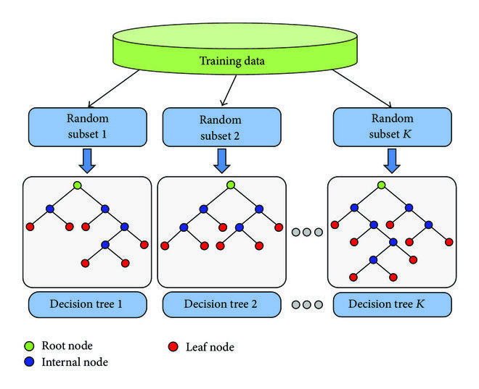
Baseline Model
We are using a Random Forest Classifier as our baseline model through TensorFlow
Using small hyper parameters
Multiple smaller trees, small max depth
We’re using this model to compare with our deep learning model

Slide 4
Deep Learning Model
We're classifying based on derived metrics (arrays of scalars)
We use LeakyReLU to avoid both vanishing gradient and dead neurons
We use HeNormal because LeakyReLU is asymmetric

Slide 5
Evaluation Metrics
No particular preference between precision (minimize false positives) and recall (minimize false negatives), so we'll use F1 as our primary metric
When we expand our dataset to include the smaller classes, we'll be interested in the balanced accuracy score

Slide 6
Thanks for watching <3

